Slide 1
Project Details
Project Title : Recommendation Systems in Social Network for Fitness Enthusiasts
Project Domain : Machine Learning and Recommendation system
Project Group Members :-
Dhanesh Phulphagar: 71802503C
Sanjay Singh: 71802582C
Sarfaraj Khan: 71725603M
Prajwal Shelke: 71802616M

Slide 2
Contents
PROJECT
Aim
Domain
Objectives
Existing System
Proposed System
Limitations of Existing System
Advantages of Proposed System
Conclusion

Slide 3
Aim
The main aim of the project is to build a social networking platform where different users are suggested using User Profile-based recommendation systems by using 5 personality traits. This system helps users to connect with the community or individuals as a companion. With the help of the companion aspect, the daily workout schedule for users and their connections in a network is more simplified, where the possibility of getting demotivated or lost is reduced. Personet – A User Profile-based Recommendation model suggests profiles based on 5 personality traits have recorded about 78 - 82 percent of evaluation accuracy whereas Collabo-rative Filtering and BOF recommendation have very low accuracy scores.

Slide 4
Project Domain
A recommendation system is an information filtering system that is used to match a subject (e.g., user) with the best items (e.g., product and friend) that is suitable for its “needs” and/or “preferences.” An FRS is a special case of a recommendation systems, where the items are a set of users (potential friends). There are three main recommendation approaches as follows.
• Content filtering recommends items that are similar to those that a user (liked/bought/viewed) in the past (or is examining in the present). Particularly, various candidate items are compared with items previously (liked/bought/viewed) by the user and the best-matching items are recommended.
• CF(Collaborative filtering) is based on the hypothesis that people who agreed in the past will agree in the future and that they will (like/buy/view) be the same (or similar) items as they have (liked/bought/viewed) the same (or similar) items in the past.
• Hybrid filtering is a combination of content filtering and CF.

Slide 5
Objectives
Create a social media web application using different software development packages supported with python based framework for generating recommendation tuples.
Allow the user to signup in a an application which will be followed by the entering information about personality traits which will help the recommender to generate matric for individual.
User can now connect with different individuals from recommended list as provide by system and start similar activity with his/her companion.
Helps individual in finding out set of people with similar fitness motivation.

Slide 6
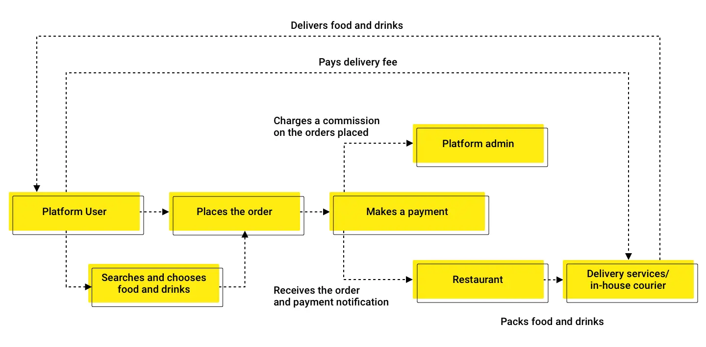
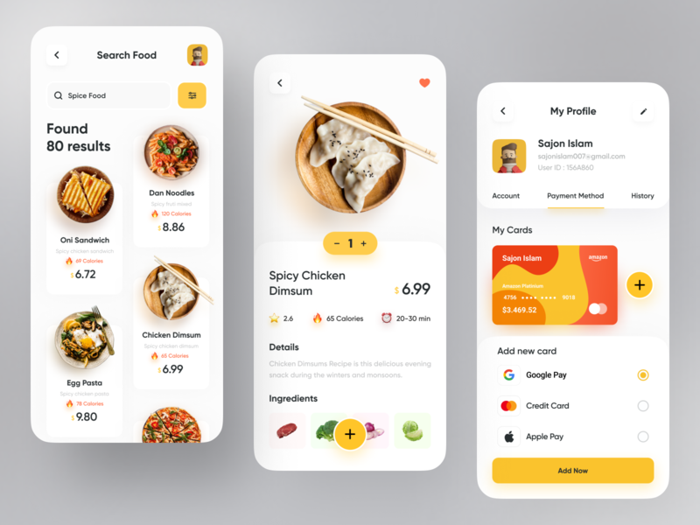
Existing System

Slide 7
Limitations of Existing System
Doesn’t helps in providing recommendations based on personality traits rather it provides recommendations based on third party nodes.
Most of the useless recommendations fill out the feed section with unproductive posts.
Previous machine leaning models propose the accuracy of only 78%.
Businesses are facilitated with hybrid and nonlinear data. Which don’t helps them in get proper analytics and targeted customer for product marketing.

Slide 8
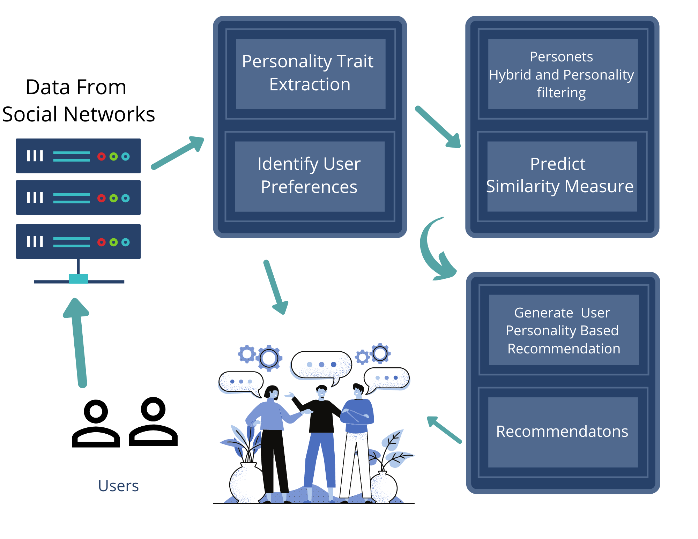
Proposed System

Slide 9
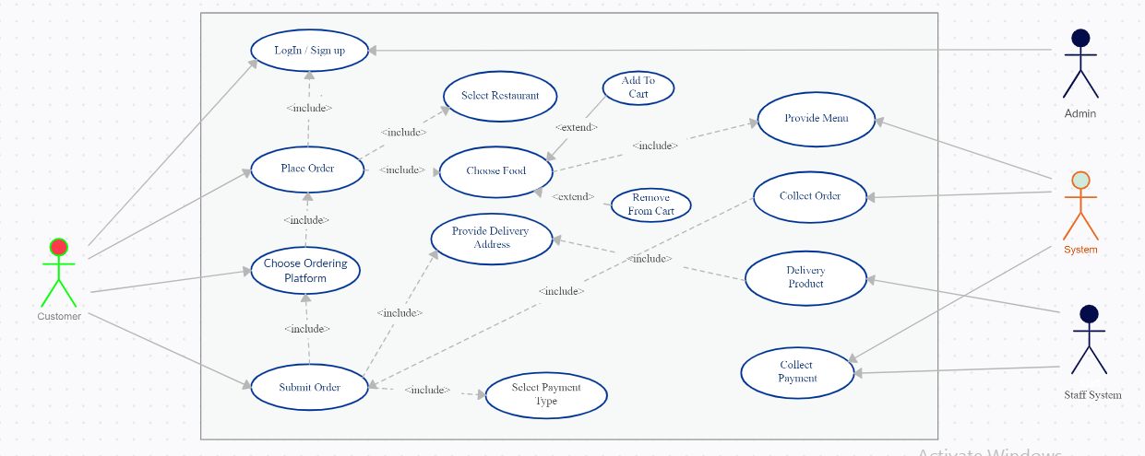

Slide 10
Advantages of Proposed System
More results can be retrieved with the same amount of exertion. Hence, less time consuming.
The proposed system can at least point you in a direction to the lesser rate, weather or not it offers the best rates every time.
Reduces the work of users from having to individually type in searches from different engines to look for resources.
More business opportunities
More availability of menu preferences and selections
User has the benefit to choose the quality and quantity of food based on the ratings provided by costumers on different food delivery applications

Slide 11
Conclusion
In this work, we present an integration of Social Networks with Friend Recommendation System for connecting fitness freaks located in nearby locations. The platform built will help individuals to find the companion/partner, which results in group fitness sessions together. The platform can create an effective social impact on young generations. We have demonstrated that by utilizing ML techniques such as Collaborative Filtering, Hybrid Filtering the end product can successfully be built with Software Engineering Techniques using SDK.

